Slide 1


Golang
Ready, set, !

Slide 2





Who are we?
Svetozara Minkova
Nikolay Pleshkov
Mayya Markova
Ivan Siderov
Martin Stoyanov

Slide 3

Our boss
Zdravko Nikolov

Slide 4




Kiril Ribarsky
And the
workshops
master

Slide 5


Basics agenda
Overview, basic project
Variables, data types
Flow control
Modules, packages
Functions
Quiz with a big prize!

Slide 6
overview
Hello world

Slide 7






Overview
High performance
Type safety
Designed at Google in 2007
Gets the best of other languages
For web services and web apps
Fast compilation
Type safety
Readability
Lots of uses

Slide 8

The go command
A CLI for managing Go source code
go [command] <arguments>
go help <topic>
go mod init <name>
go run <path to package>
go build <path to package>
go doc <topic>
Creates a new project

Slide 9

Demo

Slide 10
Variables
Let’s get started!

Slide 11

Variables
Declarations:
var keyword
:= short assignment
var x int
x = 42
var y = 43
z := 44

Slide 12

Constants
Declared with the const keyword
Cannot be declared with :=
const Pi float32 = 3.14
const Pi = 3.14
const L := 0.5
syntax error

Slide 13
Data types
Man, I wanna know everything!

Slide 14

primitives
Boolean
String
Number
bool := true
int := 3
float := 3.14
complex := 3 + 4i
uint := byte(1)
Defaults to float64
str := "Hello"
mstr := `Multiline
string`
Type here is uint8

Slide 15
Demo

Slide 16

Type Inference & TYPE CASTING
Type inference – when the type is not specified, it’s inferred from the value
Type casting – assigning the value of one data type to another
i := 1
f := float64(i)
u := uint(i)
i is an int – type inference

Slide 17

Arrays & Slices
Array – collection with fixed size
Slice – dynamically-sized collection
var arr [2]int
arr[0] = 1
arr[1] = 2
arr2 := [2]int{1, 2}
s := []int{1, 2}
s = append(s, 3)
s2 := make([]int, 2, 5)
s3 := s[1:3]

Slide 18
Demo

Slide 19



Structs
Collection of fields
Methods are defined separately
type human struct {
name string
age int
}
func (h human) speak(words string) {
fmt.Println(words)
}
to be continued…

Slide 20

maps
Key-value pairs
Both types are required
fileExtensions := map[string]string{
"Golang": ".go",
}
val, ok := fileExtensions["Golang"]
The comma here is required

Slide 21
Demo
Notes:
Пример с employee struct и employeeInfo map

Slide 22


pointers
Hold the memory address of a value
& – generates a pointer
* – denotes the pointer’s underlying value or reads the value
Int pointer with nil value
var add *int
num := 42
add = &num
val := *add
Holds the address of num, e.g. 0xc0000ae008
Reads the value, stored in that address - 42

Slide 23
Demo

Slide 24
Flow control
If I win the quiz, I’ll get the big prize

Slide 25

IF
() are optional, but {} are required
Can start with a short statement to execute before the condition
Scope of the created variables is in the if/if-else block
No ternary operator
if num := 15; num % 2 == 0 {
fmt.Println("even")
} else {
fmt.Println("odd")
}

Slide 26

Switch
switch letter:=getLetter(); letter {
case 'a', 'e', 'o', 'u', 'i':
fmt.Println("Vowel")
case 'y':
fmt.Print("Vowel and ")
fallthrough
default:
fmt.Println("Consonant")
}
() are optional, but {} are required
Can have initialization statement
Cases
Commas separate multiple expressions
Not necessarily numeric
No break
fallthrough keyword

Slide 27

Switch
Switch without a condition is equivalent to if-else chain
Case statements must be boolean
t:= time.Now()
switch {
case t.Hour() < 12:
fmt.Println("Good morning!")
default:
fmt.Println("Good afternoon!")
}

Slide 28

Loops
One keyword for all types of loops – for
() are optional, but {} are required
Initialization and increments parts can be omitted – acts like while
for j := 5; j < 10; j++ {
fmt.Println(j)
}

Slide 29

Loops
n := 0
for {
n++
if n == 10 {
break
}
if n%2 == 0 {
continue
}
fmt.Println(n)
}
Infinite loop – when no condition is specified
It can be stopped by:
break
return
Force the next iteration – with continue

Slide 30

Range Operator
The range operator is used to iterate over various data structures:
Over arrays and slices – index and value
Over maps – key and value
Over strings – index and Unicode value

Slide 31
Demo

Slide 32
functions
Declare function, not war

Slide 33

Functions
Defined with the func keyword, followed by the function name and its parameters
func add(x, y int) int { return x + y }
sum := add result := sum(3, 4)
Functions are first-class citizens

Slide 34

Functions
Possible to return multiple values
func apply(f func(int) int, a int) int { return f(a) }
func square(n int) int { return n * n }
result := apply(square, 10)
Functions are first-class citizens

Slide 35

Functions
func adder() func(int) int { sum := 0 return func(x int) int { sum += x return sum } }
Closures manipulate the state of their enclosing environment
Variadic functions accept a variable number of arguments
func vSum(nums ...int) int {​ total := 0​ for _, num := range nums {​ total += num​ } ​ return total​ }​
​ vResult := vSum(1, 2, 3, 4)

Slide 36

ANONYMOUS FUNCTIONS
Anonymous functions also known as function literal
Can be treated and utilized just like any other function
Support for functional programming style
​func() {
fmt.Println("I am anonymous")
}()
Invoke immediately

Slide 37

ANONYMOUS FUNCTIONS
Context-specific usage
Concise and modular code
Usage:
Callbacks
Goroutines
Higher-order functions
Event handlers

Slide 38

DEFERRED FUNCTIONS
The defer keyword schedules a function call to be executed when the surrounding function returns
Usage:
Simplify cleanup tasks
Free resources after function completes

Slide 39

DEFERRED Functions
Open a file in a function, then defer the Close method of the file to be called when the functions returns
f, err := os.Open("data.txt") // … defer f.Close() scan1 := bufio.NewScanner(f) for scan1.Scan() { pl("Prime :", scan1.Text()) }

Slide 40
Demo

Slide 41
methods
I have no idea what I’m doing

Slide 42


Methods
Method – a function, associated with a type
Defined with func, followed by:
the receiver type
the method name
the parameters and return values.
type Rect struct {
width float64
height float64
}
func (r Rect) Area() float64 {
return r.width * r.height
}

Slide 43
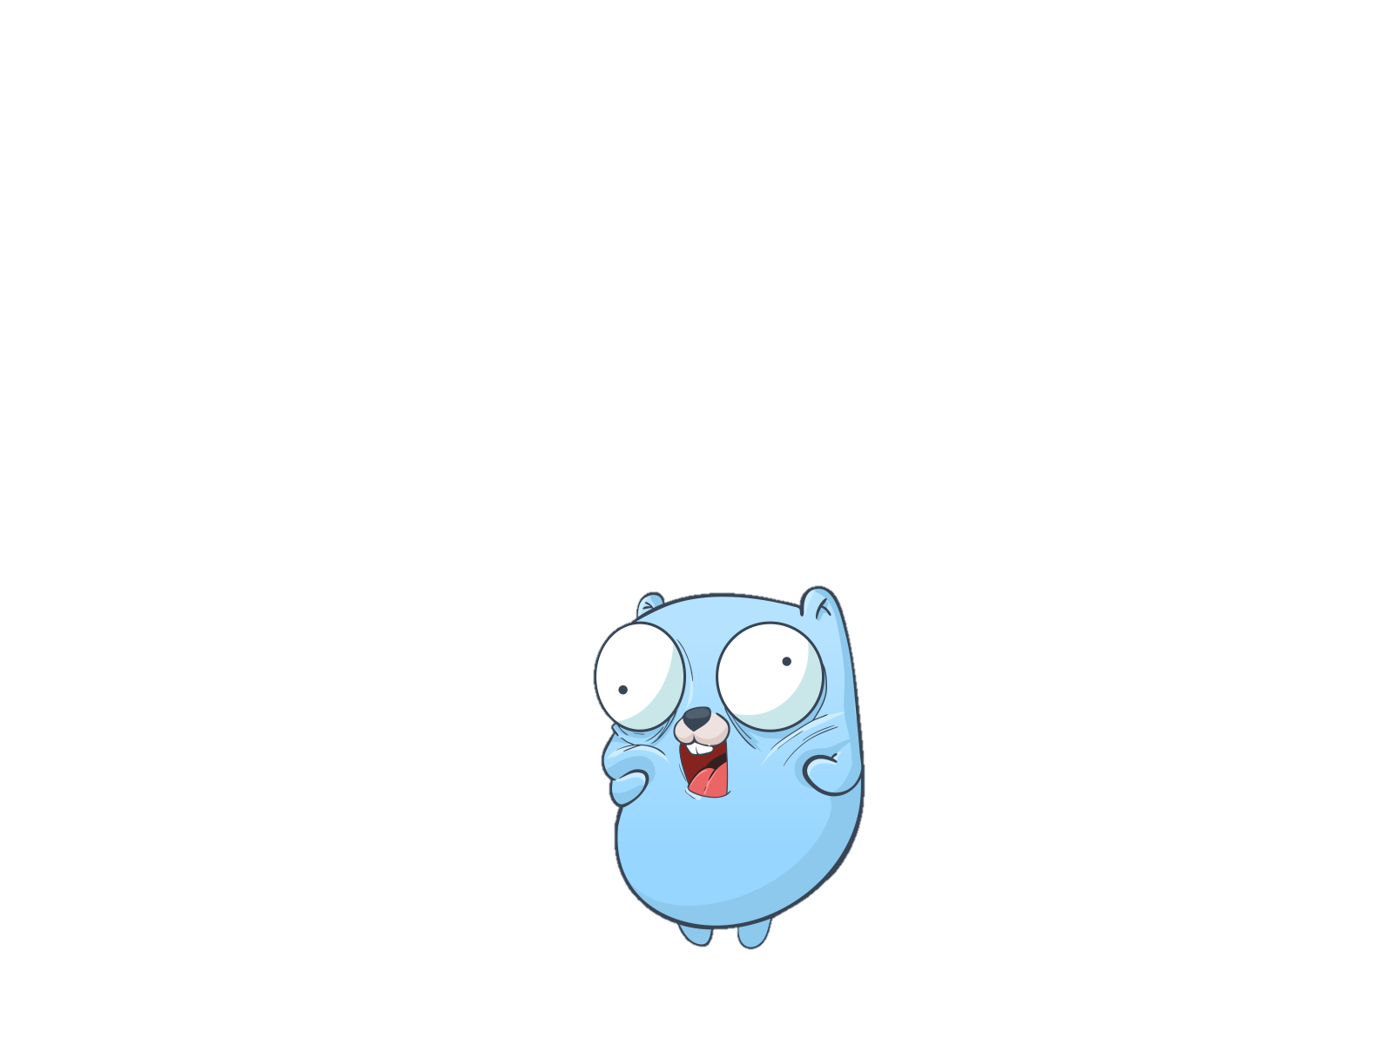
Methods
Could be defined with:
value receivers
pointer receivers
func (e Employee) IncrementSalary() {
e.Salary++
}
e is a pointer
func (e *Employee) IncrementSalary() {
e.Salary++
}

Slide 44
Demo

Slide 45

METHODS VS FUNCTIONS
Both used to define reusable pieces of code, but:
Functions are:
can be called from anywhere
not associated with any particular type
Methods are:
associated with a particular type
can only be called on instances of that type, and they have access to the data stored in those instances

Slide 46
PACKAGES
Are we going to deliver something?

Slide 47

packages
Basic building block of a Go program
Naming convention – lower case, single word
2 Types:
Executable – contains main
Utility – everything else
import keyword
() for multiple packages
import(
"fmt"
"math/rand"
)

Slide 48
Access Modifiers
I’m just here for the internet access

Slide 49
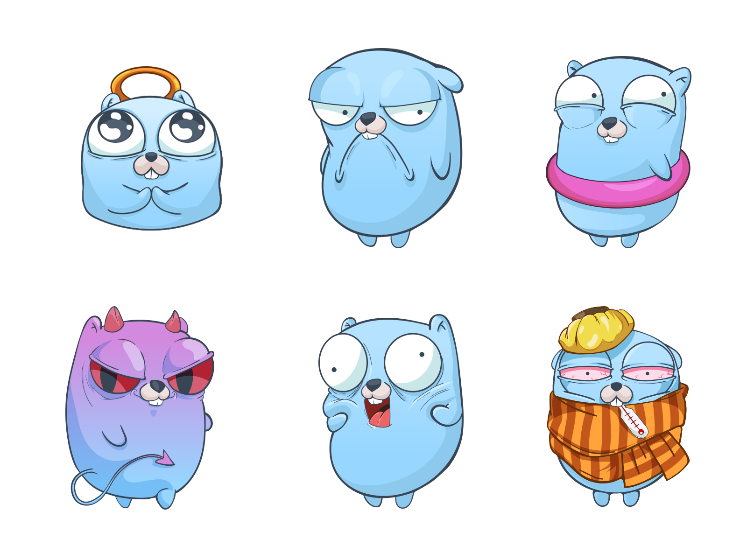

Access Modifiers
2 two forms of access:
unexported – lowercase
Exported - Uppercase
func localFunction() {
fmt.Println("I'm local!")
}
func ExportedFunction() {
fmt.Println("I'm exported!")
}

Slide 50

Modules
Modules consist of packages
go.mod
module github.com/GolangWorkshop/golang-workshop
go 1.19
require (
cloud.google.com/go/pubsub v1.17.1
cloud.google.com/go/storage v1.10.0
)
Go version
Module Path

Slide 51
Demo

Slide 52
Dependency Management
I thought that I’m the boss

Slide 53

Go.mod
Root of dependency management
module github.com/GolangWorkshop/golang-workshop
go 1.19
require (
cloud.google.com/go/pubsub v1.17.1
cloud.google.com/go/storage v1.10.0
)
Go version
Module Path
Dependencies

Slide 54
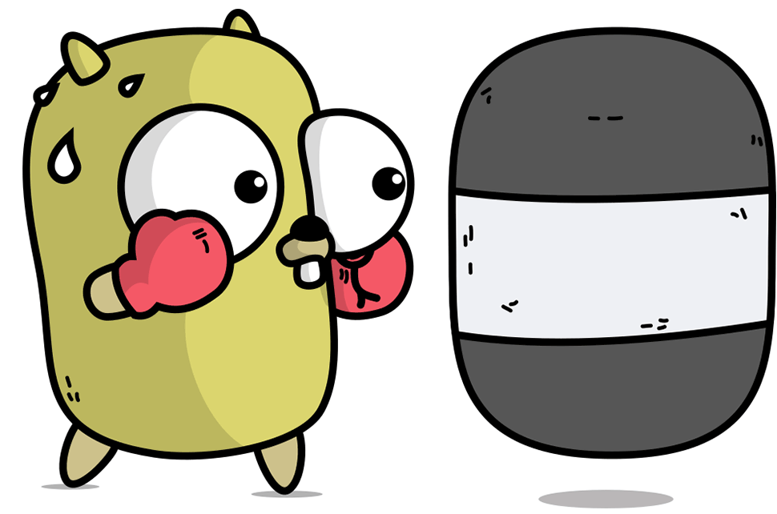
Initialization And dependencies
go mod init github.com/gitusername/reponame - initialize project
go get . - add dependency
go mod tidy – remove unused dependencies and synchronize

Slide 55
Demo
Notes:
Project initialization and dependencies

Slide 56
Build
It’s under code-struction

Slide 57
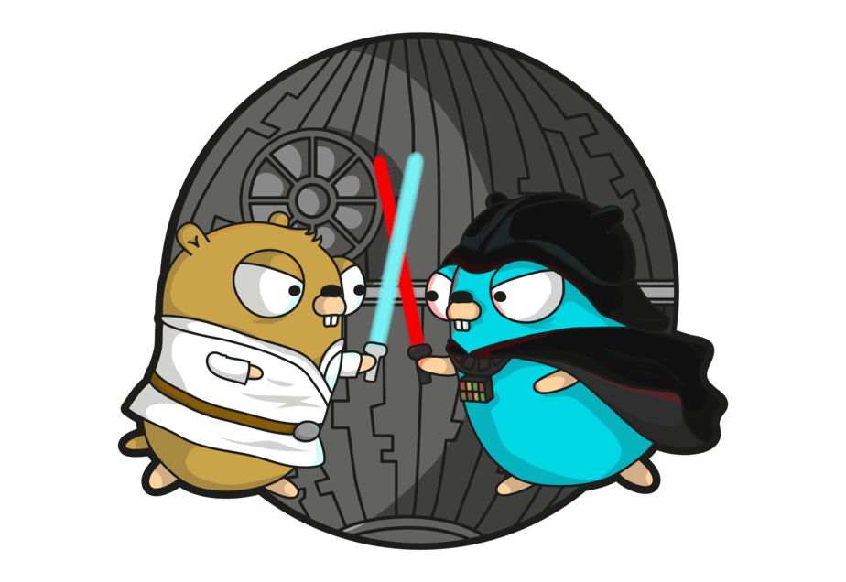
set GOOS=linux
Go Build
go build <package>
Result is saved only for executable packages
GOOS and GOARCH
$Env:GOOS = "linux"
env GOOS=linux

Slide 58
Demo
Notes:
Project initialization and dependencies

Slide 59


quiz

Slide 60

Q & A
Rare or medium-rare?

Slide 61


Thanks for your attention!

